Slide 1


HEALTHCARE
ANALYSIS
SQL - PROJECT
- K.S.AKSHAYA
1

Slide 2


Agenda
Introduction
Abstract
Problem Statement
Objective
About Dataset
Analysis
Insights
Conclusion
2

Slide 3

INTRODUCTION
The healthcare industry manage vast amounts of patient data, medical records, and hospital operations. Efficient management of healthcare systems is crucial for ensuring quality care, optimizing resource allocation, and maintaining operational efficiency
. As the healthcare industry continues to evolve, data analytics will become increasingly important in helping hospitals meet the needs of their patients
3

Slide 4

ABSTRACT
This project analyzes healthcare management data using SQL to gain insights into patient care, resource allocation, and hospital efficiency.
By querying patient records, treatments, and financial data, key trends in patient demographics, hospital performance, and treatment outcomes were identified.
By doing so, healthcare management can identify areas where improvements are needed and make data-driven decisions to enhance service quality and operational workflows.
4

Slide 5
PROBLEM STATEMENT
In the healthcare management system, there is a critical need to improve patient care through the optimization of appointment scheduling, effective management of the billing process, and reduction of patient wait times
The current system struggles with scheduling inefficiencies, billing inaccuracies, and lack of insights into patient-doctor interactions, leading to operational challenges..
The goal is to implement a data-driven approach that integrates patient, doctor, billing, and appointment data to optimize resource allocation, ensure accurate and timely billing, and provide actionable insights for improving clinical outcomes and overall patient satisfaction.
5

Slide 6
OBJECTIVE
The objective is to develop a comprehensive healthcare management system that leverages integrated data to improve the quality of patient care.
Analyze patient appointment data to identify trends and patterns.
Evaluate doctor performance and workload distribution.
Analyze billing data to identify financial trends and pending payments.
Provide recommendations based on findings to optimize healthcare resource allocation.
.
6

Slide 7


ABOUT DATASET
Patient table
Doctor table
Contains personal and health details of patients
ID, name, gender, contact, DOB
Includes doctor details ID, name, specialization, contact.
7

Slide 8
Appointments table
Billing table
Tracks patient appointments with appointment ID, patient ID, doctor ID, date, status
Records billing information ID, appointment ID, total amount, payment status, billing date.
8

Slide 9




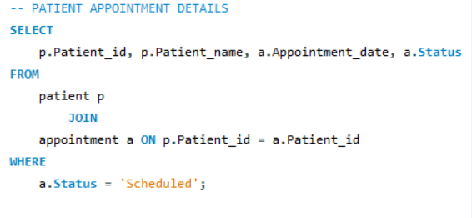
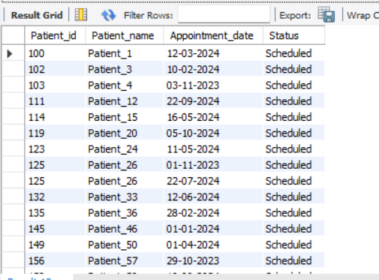
Analysis
PATIENT APPOINTMENT DETAILS
This query retrieves scheduled appointments for all patients, helping the facility monitor upcoming appointments and manage scheduling effectively
9

Slide 10
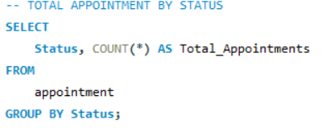
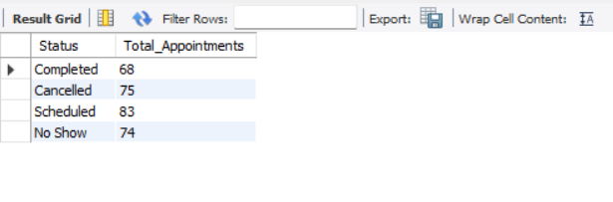
TOTAL APPOINTMENT BY STATUS
Helps to understand the appointment status
This helps identify patterns in cancellations or missed appointments.
10

Slide 11
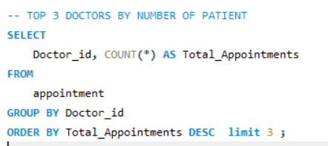
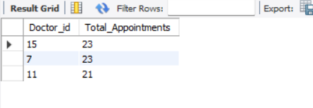
TOP 3 DOCTORS BY NUMBER OF PATIENTS
Identify the most active doctors based on the number of appointments they handle
It is useful for workload balancing and resource allocation.
11

Slide 12
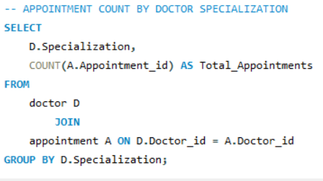
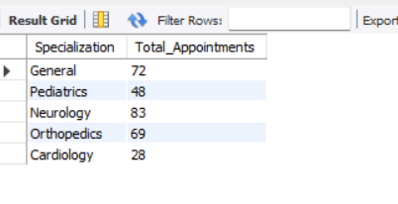
APPOINTMENT COUNT BY DOCTOR SPECALIZATION
To analyze which medical specializations are in high demand.
It helps to allocate resources and plan for future hires
12

Slide 13
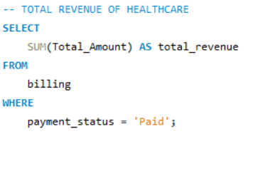
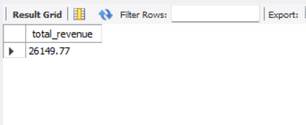
TOTAL REVENUE OF HEALTHCARE
Calculate total revenue from paid bills to assess the financial performance of the healthcare facility.
13

Slide 14
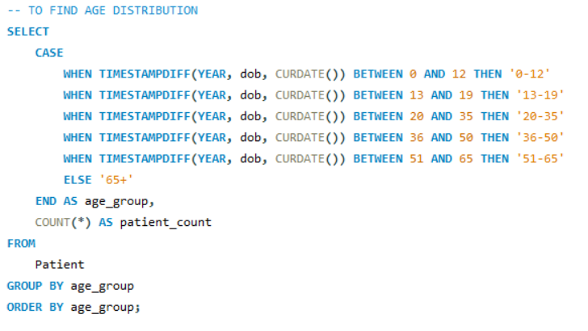
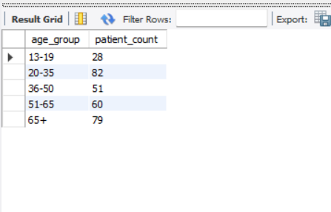
AGE DISTRIBUTION OF PATIENTS
To understand the profile of the patient population, which helps in tailoring healthcare services, resource allocation, and identifying age-specific health trends.

Slide 15
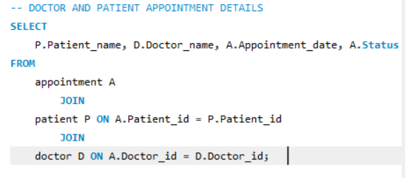
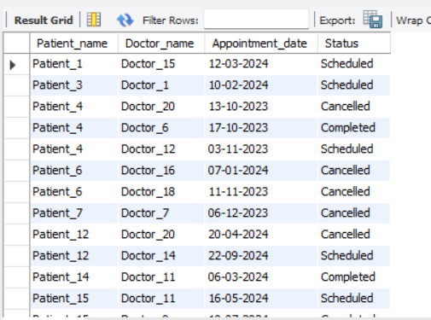
DOCTOR AND PATIENT APPOINTMENT DETAILS
It's useful for analyzing doctor-patient interactions.
14

Slide 16
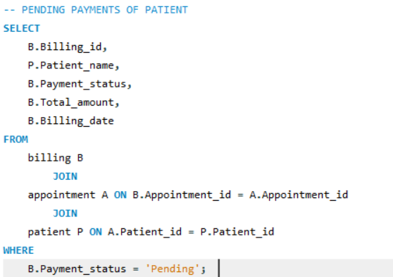
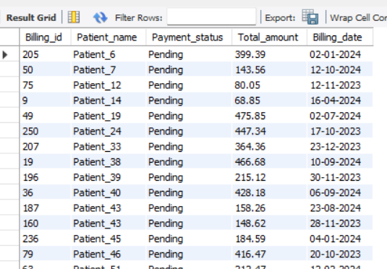
PENDING PAYMENTS OF PATIENT
This helps in managing cash flow and following up on unpaid bills.
15

Slide 17
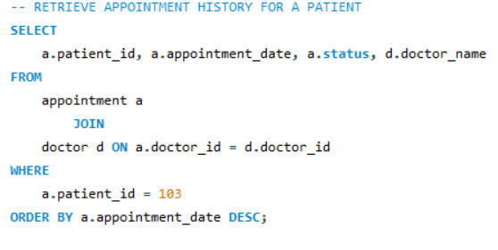
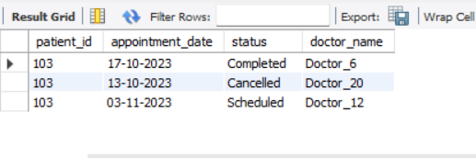
APPOINTMENT HISTORY FOR A PATIENT
This query provides a patient's appointment history, allowing providers to review past interactions and inform future care decisions.
17

Slide 18
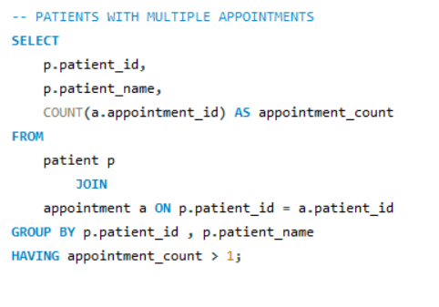
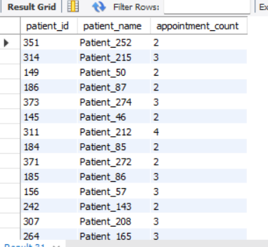
PATIENTS WITH MULTIPLE APPOINTMENTS
This query lists patients who have multiple appointments, which may indicate ongoing care needs or chronic conditions that require follow-up.
18

Slide 19
INSIGHTS
Patient Demographics and Health Trends
Doctor Utilization and Specialization
Appointment Management
Billing and Financial Health
19

Slide 20
CONCLUSION
This healthcare analysis project using SQL provided valuable insights into the operations of a healthcare facility.
By analyzing patient appointment patterns, doctor performance, and financial data, we identified key trends that can help optimize resource allocation, improve patient care, and enhance operational efficiency
The findings from this project demonstrate how healthcare providers can leverage data to identify gaps in service, manage workloads effectively, and ensure financial sustainability.
20

Slide 21
THANK YOU
21

